Slide 1
Beginning
Tableau
Workshop Materials: go.ncsu.edu/begintableau
Mike Nutt &
Natalia Lopez
NC State University Libraries

Slide 2
How this Workshop Will Work
You may want to print activity guide from go.ncsu.edu/begintableau
Download Tableau: public.tableau.com
General info first and then hands-on activity
I will demonstrate first and give you time to do it on your own
If you’re stuck or having problems, use chat
If you have a question that others might like to hear the answer to, there will be pauses for questions
Unmute yourself, but be sure to mute again when you’re finished asking question
Use keyboard shortcuts for app switching. Cmd Tab for Mac and Alt Tab for Windows.

Slide 3
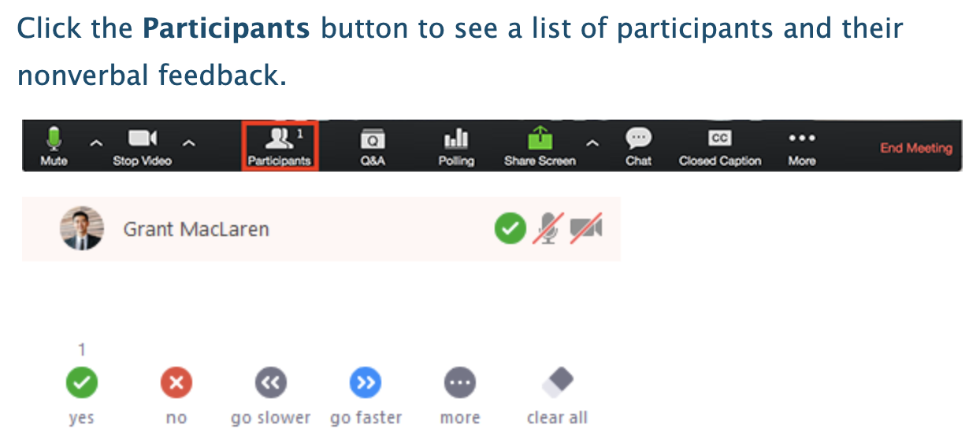

Slide 4
Data Visualization Process
getting data
getting to know the data
setting goals, asking questions
determining if a visualization is needed
deciding what to visualize
cleaning
visualizing
designing (potentially re-visualizing it with a different tool)
exporting/embedding

Slide 5
What is Tableau? www.tableau.com
Interactive data visualization and analytics application
Tableau Public is free for everyone (public.tableau.com)
Tableau Desktop is free for students, instructors, and researchers (tableau.com/academic)
Other products (Prep, Server, Online)
You can create and share graphs, maps, live dashboards
You can publish anywhere on the web using Tableau Public
Notes:
Prep is included in the academic license

Slide 6
Tableau Gallery
Let’s see some examples!
public.tableau.com/s/gallery
James Patterson Book Checkouts from Seattle Public Library

Slide 7
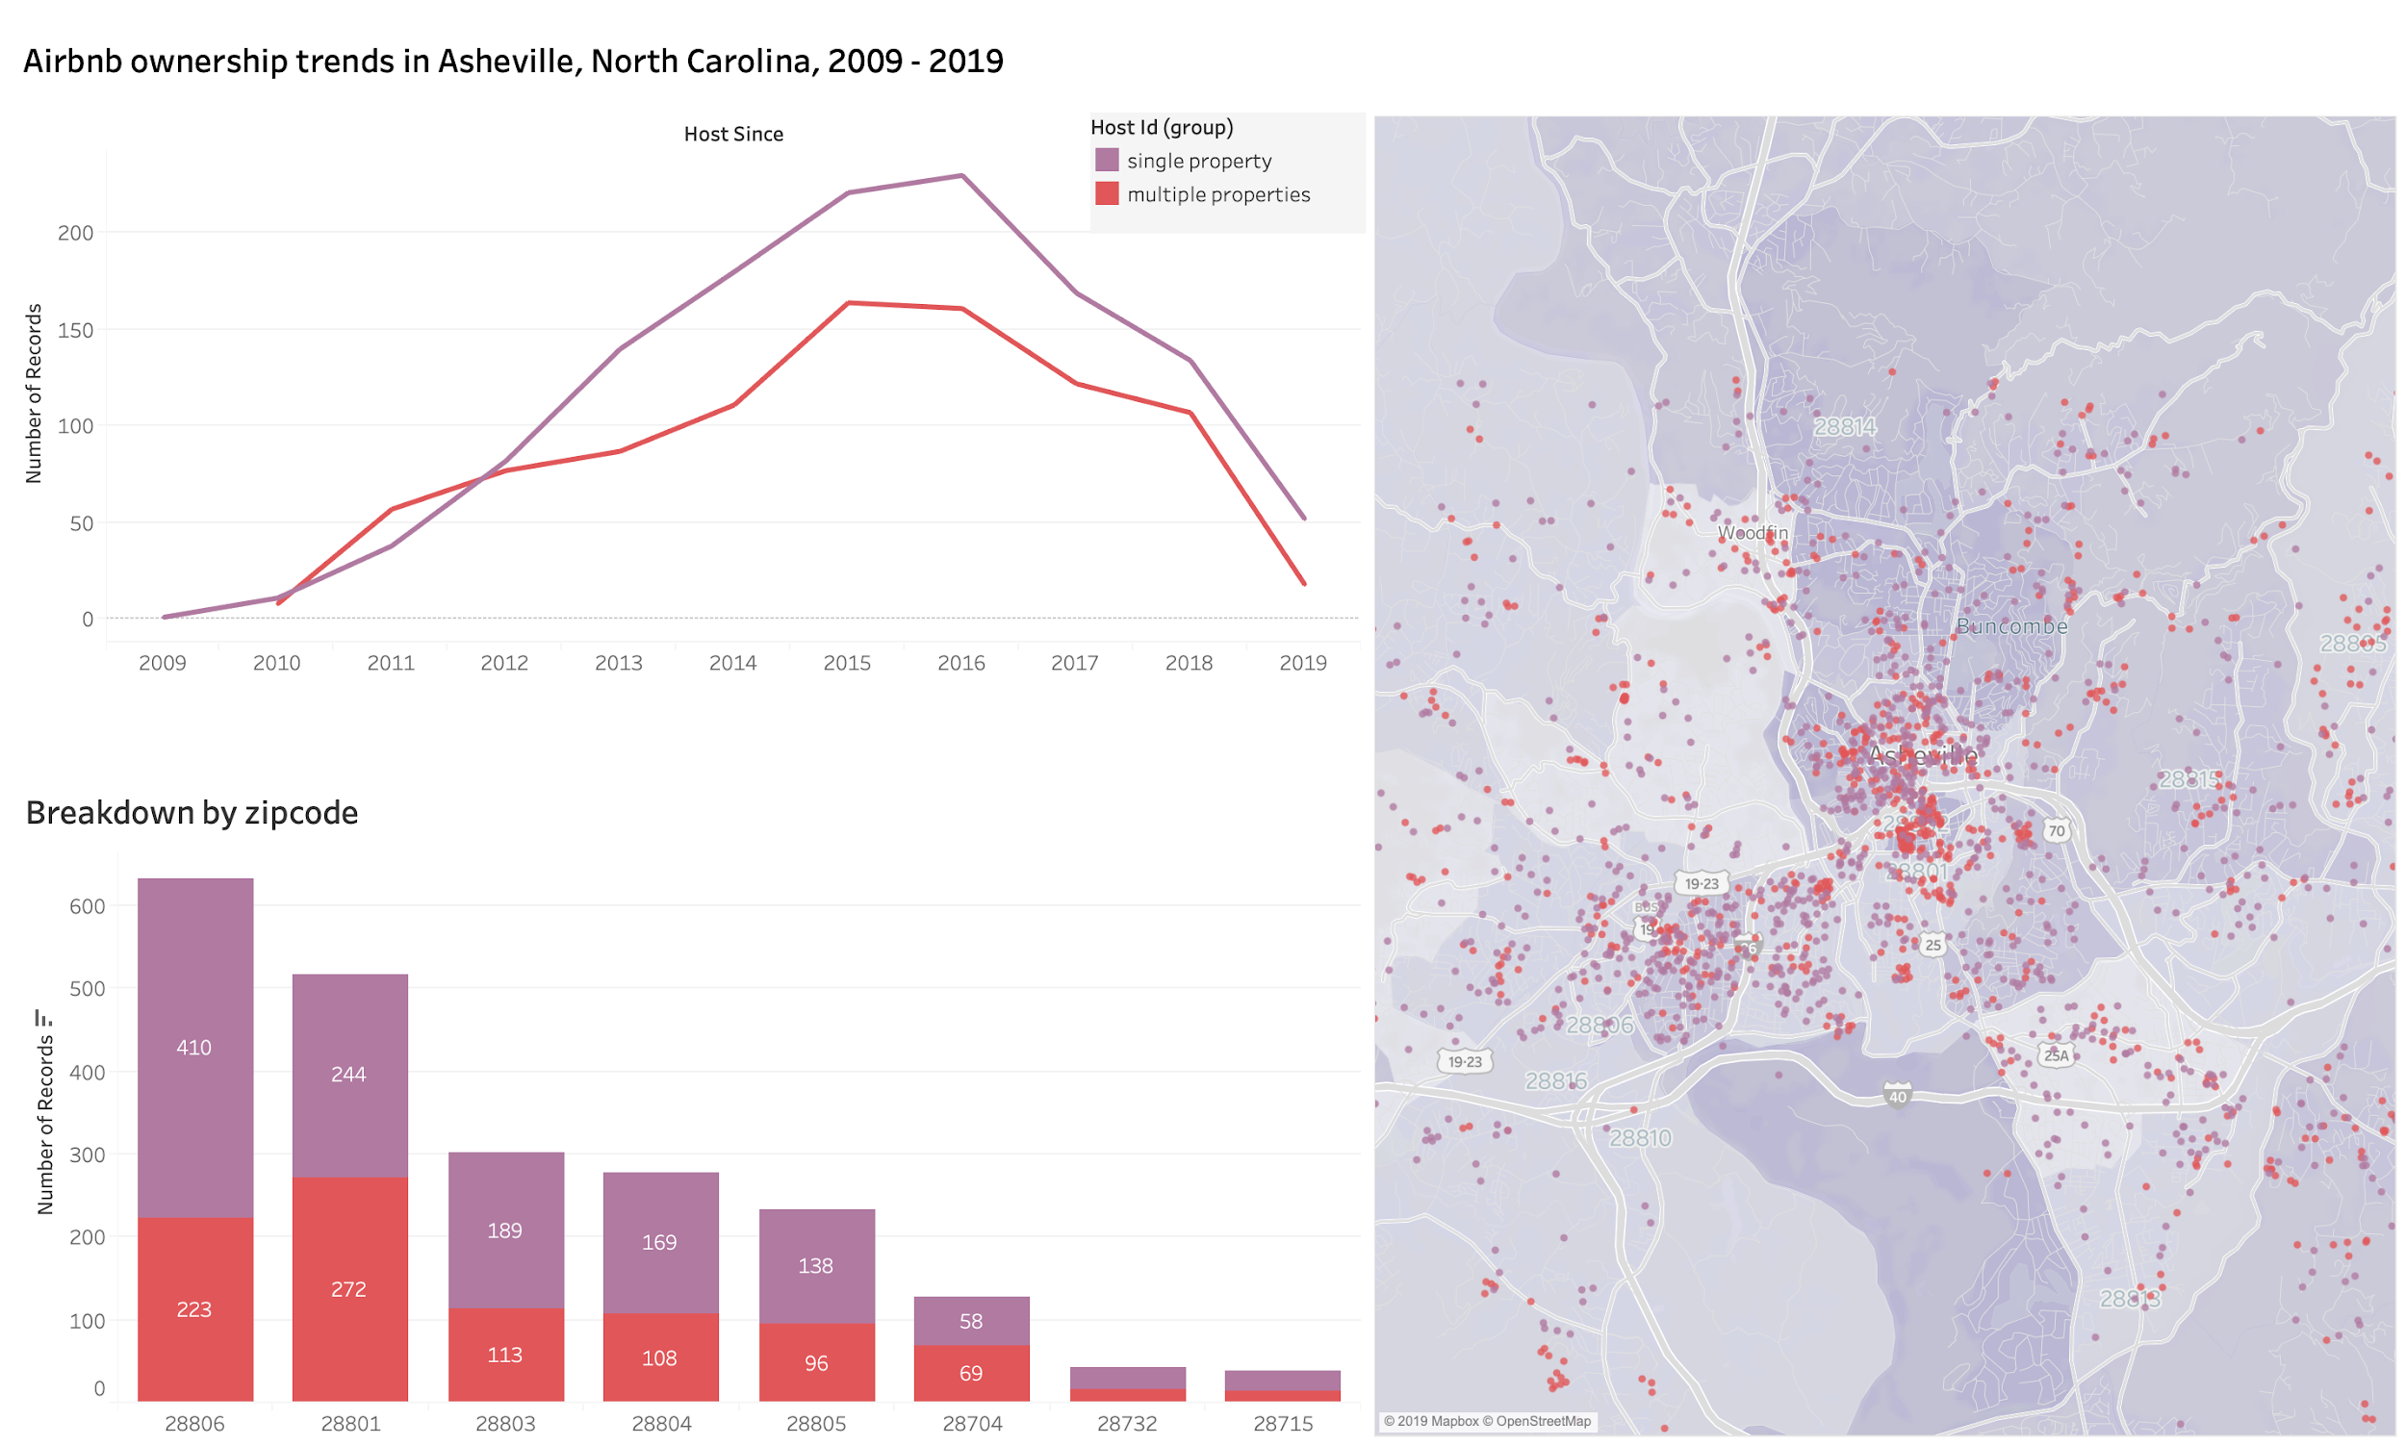
Demo of what we are making today

Slide 8
Learning Objectives
After today, you should be able to:
upload a dataset to Tableau
create multiple visualizations and a dashboard
edit the colors of a visualization
create a filter
create a dashboard action
publish your visualization
find further assistance
If you have any questions, please raise your hand!

Slide 9
Explore data
Open airbnb_asheville.csv in Excel
What do you notice about the data?
What are some of the questions you could ask with data like this?

Slide 10
Getting started questions
How many airbnbs in Asheville, NC are listed by an owner with a single property? How many are owned by someone who runs multiple properties?
What is the spatial distribution of airbnb properties?
Are there any ownership trends over the last ten years?

Slide 11
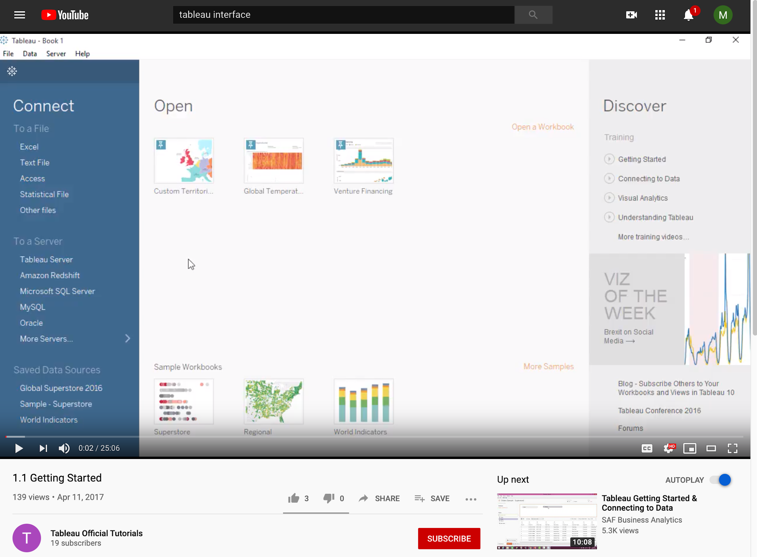
Tableau Interface
https://youtu.be/PX1-TCwKHus?t=8

Slide 12
The Anatomy of a Tableau Viz
What do the ‘marks’ in this viz represent?
X-axis?
Y-axis?
Color?
Viz Labels?
What is the breakdown of airbnb owners in terms of single and multiple property owners?

Slide 13
The Anatomy of a Tableau Viz
What do the ‘marks’ in this viz represent?
X-axis?
Zipcodes
Y-axis?
# of properties Color?
Single/multiple owners Viz Labels?
# of properties
What is the breakdown of airbnb owners in terms of single and multiple property owners?

Slide 14
The Anatomy of a Tableau Viz
What do the ‘marks’ in this viz represent?
X-axis? Columns
Zip codes
Y-axis? Rows
# of properties Color?
Single/multiple owners Viz Labels?
# of properties
What is the breakdown of airbnb owners in terms of single and multiple property owners?

Slide 15
Your turn! Try to re-create the viz below!
What do the ‘marks’ in this viz represent?
X-axis? ‘COLUMNS’
Y-axis? ‘ROWS’
Color?
Were there any trends for airbnb ownership over the last ten years?

Slide 16
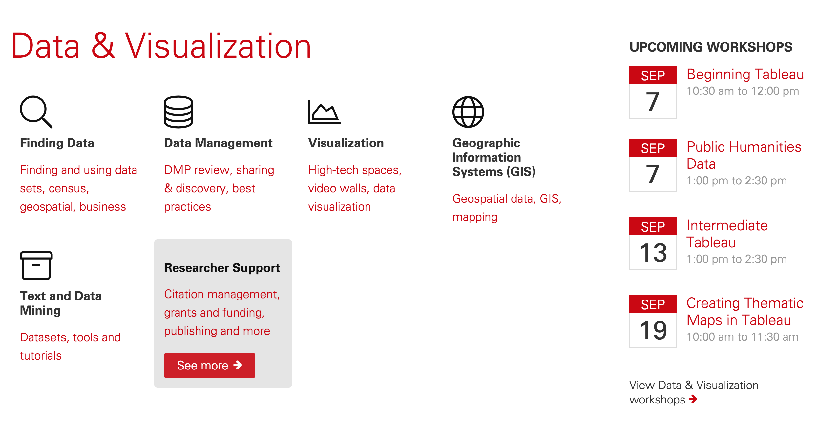
Data & Visualization Services lib.ncsu.edu/services/data-visualization

Slide 17
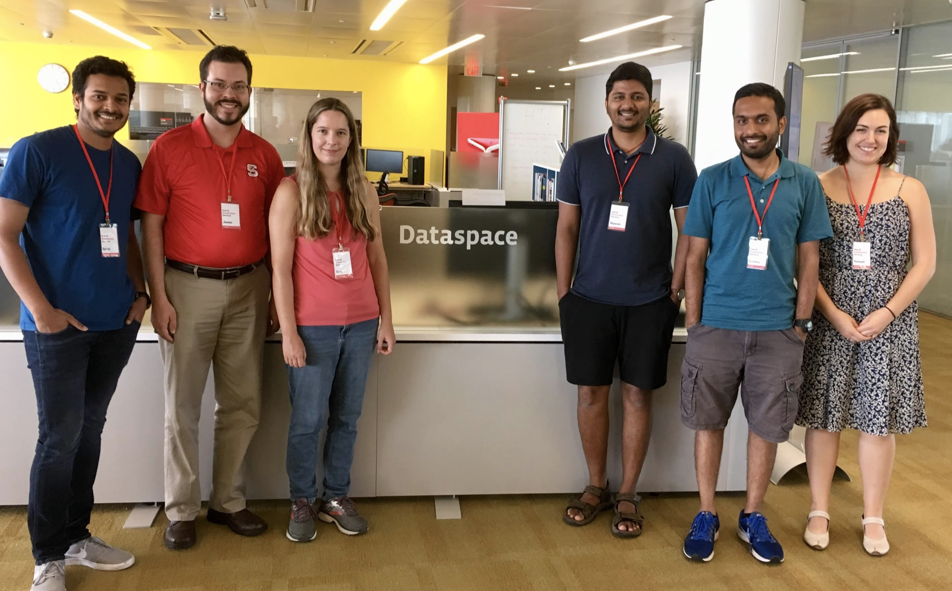
Data Science Consultants can answer questions
go.ncsu.edu/dataspace

Slide 18
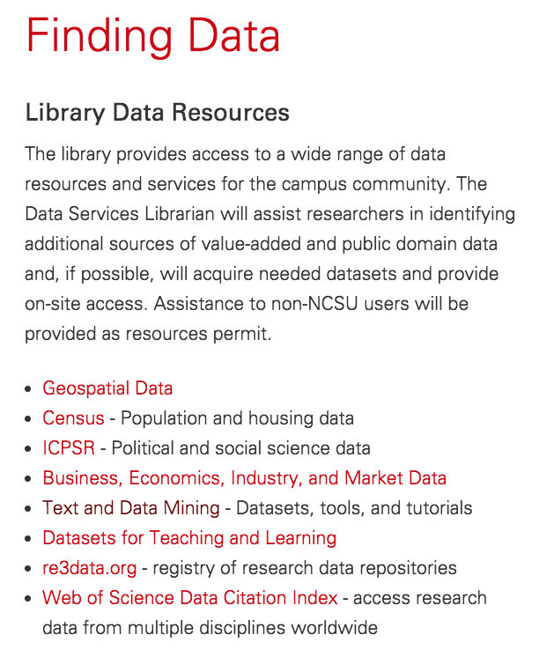
Data Sources for Learning lib.ncsu.edu/do/finding-data

Slide 19
Evaluation
go.ncsu.edu/libeval

